Slide 1
Azure Cosmos DB Data Modelling & Partitioning

Slide 2
What is Azure Cosmos DB?
Microsoft's NoSQL database on Azure
Non-relational and
horizontally scalable
Notes:
Cosmos DB = Base de données distribuée, disponible partout dans le monde, multi modèles, haute performance et Always ON
Offre NoSQL de Microsoft dans Azure
NoSQL = pas relationnelle et qui scale de manière horizontale

Slide 3



What is Azure Cosmos DB?
horizontally scalable
Unlimited throughput
Unlimited storage capacity

Slide 4

What is Azure Cosmos DB?
non-relational

Slide 5
What is Azure Cosmos DB?
non-relational
and horizontally scalable

Slide 6
What is partitioning?

Slide 7

What is partitioning?
logical partitions

Slide 8
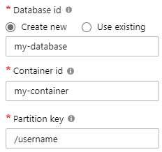
What is partitioning?
Andrew
Thomas
Deborah
Tim
Mark
Theo
Notes:
Limits:
2MB per document
20GB per partition

Slide 9
What is partitioning?
Max size: 2 MB
Max size: 20 GB

Slide 10

What is partitioning?

Slide 11
What is partitioning?

Slide 12
What is partitioning?

Slide 13

What is partitioning?
Andrew
Deborah
Tim
Mark
Thomas
Theo
SELECT * FROM c WHERE c.username = 'Mark'
our partition key

Slide 14
What is partitioning?
Andrew
Deborah
Tim
Mark
Luis
Theo
SELECT * FROM c WHERE c.favoriteColor = 'orange'
?

Slide 15
Partition Design (1 of 2)
IMPORTANT TO SELECT THE “RIGHT” PARTITION KEY
Partition keys acts as a means for efficiently routing queries and as a boundary for multi-record transactions.
KEY MOTIVATIONS
Distribute Requests
Distribute Storage
Intelligently Route Queries for Efficiency

Slide 16

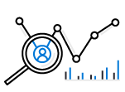



Partition Design (2 of 2)
EXAMPLE SCENARIO
Contoso Connected Car is a vehicle telematics company. They are planning to store vehicle telemetry data from millions of vehicles every second in Azure Cosmos DB to power predictive maintenance, fleet management, and driver risk analysis.
The partition key we select will be the scope for multi-record transactions.
WHAT ARE A FEW POTENTIAL PARTITION KEY CHOICES?
Vehicle Model
Current Time
Device Id
Composite Key – Device ID + Current Time
Example – Contoso Connected Car
Notes:
Design Goals for Choosing a Good Partition Key
Distribute the overall request + storage volume
Avoid “hot” partition keys
Partition Key is scope for [efficient] queries and transactions
Queries can be intelligently routed via partition key
Omitting partition key on query requires fan-out
Steps for Success
Ballpark scale needs (size/throughput)
Understand the workload
# of reads/sec vs writes per sec
Use 80/20 rule to help optimize bulk of workload
For reads – understand top X queries (look for common filters)
For writes – understand transactional needs understand ratio of inserts vs updates
General Tips
Don’t be afraid of having too many partition keys
Partitions keys are logical
More partition keys => more scalability

Slide 17
Partition Key Choices (1 of 2)
VEHICLE MODEL (e.g. Model A)
CURRENT MONTH (e.g. 2018-04)
Most auto manufactures only have a couple dozen models. This will create a fixed number of logical partition key values; and is potentially the least granular option.
Depending how uniform sales are across various models – this introduces possibilities for hot partition keys on both storage and throughput.
Auto manufacturers have transactions occurring throughout the year. This will create a more balanced distribution of storage across partition key values.
However, most business transactions occur on recent data creating the possibility of a hot partition key for the current month on throughput.
Storage Distribution
Throughput Distribution
Storage Distribution
Throughput Distribution
Rodel
Rodel
2018-03
2018-03
Prisma
Prisma
2018-04
2018-04
Turlic
Turlic
2018-05
2018-05
Coash
Coash
2018-06
2018-06
Example – Contoso Connected Car
Notes:
Date of flight
Use the example of a user searching for a flight. The user typically enters a date and the search is focused on that specific date
Search requests will target a predictable partition
Searching for a different date requires a new query
Searching across multiple dates (functionality not available with every airline) will create cross-partition queries

Slide 18
Partition Key Choices (2 of 2)
DEVICE ID (e.g. Device123)
COMPOSITE KEY (Device ID + Time)
Each car would have a unique device ID. This creates a large number of partition key values and would have a significant amount of granularity.
Depending on how many transactions occur per vehicle, it is possible to a specific partition key that reaches the storage limit per partition key
This composite option increases the granularity of partition key values by combining the current month and a device ID. Specific partition key values have less of a risk of hitting storage limitations as they only relate to a single month of data for a specific vehicle.
Throughput in this example would be distributed more to logical partition key values for the current month.
Storage Distribution
Throughput Distribution
Storage Distribution
Throughput Distribution
C49E27EB
C49E27EB
C49E27EB-2018-05
C49E27EB-2018-05
FE53547A
FE53547A
C49E27EB-2018-06
C49E27EB-2018-06
E84906BE
E84906BE
4376B4BC-2018-05
4376B4BC-2018-05
4376B4BC
4376B4BC
4376B4BC-2018-06
4376B4BC-2018-06
Example – Contoso Connected Car
Notes:
Aircraft Type
Imbalance of aircraft types when comparing smaller vs. bigger routes

Slide 19
Partition Key Selection
Contoso Connected Car is collecting and storing vehicle telemetry data from millions of vehicles. The team has decided to partition based on a composite key consisting of device id + current time when the interaction occurred.
Airport
Airport
Airport
Airport
Airport
Airport
Example – Contoso Connected Car
Notes:
The interaction data will likely be used to make future business decisions
Which features should we add?
Who’s content should we include?
Are there any widespread issues or bugs?

Slide 20
Partition Key Scenario (1 of 2)
Interaction that occurred on:
September 25, 2016 at 4:15 AM UTC
C49E27EB-2016
C49E27EB-2016-09
C49E27EB-2016-09-25
C49E27EB-2016-09-25-04
C49E27EB-2016-09-25-04-15
Example – Contoso Connected Car
Notes:
Example of partition key scenario

Slide 21
Partition Key Scenario (2 of 2)
Interaction that occurred on:
September 25, 2016 at 4:15 AM UTC
Will this partition be larger than the current max storage for a single partition key?
C49E27EB-2016
C49E27EB-2016-09
A higher cardinality key allows Azure Cosmos DB to grow and evenly distribute your data; but may also impact ease of querying
C49E27EB-2016-09-25
C49E27EB-2016-09-25-04
C49E27EB-2016-09-25-04-15
Example – Contoso Connected Car
Notes:
Example of partition key scenario
Max Storage for a Single Partition Key
10 GB, 10,000 RU/s
If you have a single-partition container, your container’s max size is 10 GB
A higher cardinality of partition key allows the system to grow and evenly distribute volume
There is zero value in artificially limiting the number of partition keys. Partition key values are already logical partitions that get co-located on a smaller number of physical partitions. There is no good reason to artificially limit the cardinality of the number of logical partition keys

Slide 22
Partitions Best Practices
Best Practices: Design Goals for Choosing a Good Partition Key
Distribute the overall request + storage volume
Avoid “hot” partition keys
Partition Key is scope for multi-record transactions and routing queries
Queries can be intelligently routed via partition key
Omitting partition key on query requires fan-out
Steps for Success
Ballpark scale needs (size/throughput)
Understand the workload
# of reads/sec vs writes per sec
Use pareto principal (80/20 rule) to help optimize bulk of workload
For reads – understand top 3-5 queries (look for common filters)
For writes – understand transactional needs
General Tips
Build a POC to strengthen your understanding of the workload and iterate (avoid analyses paralysis)
Don’t be afraid of having too many partition keys
Partitions keys are logical
More partition keys → more scalability

Slide 23
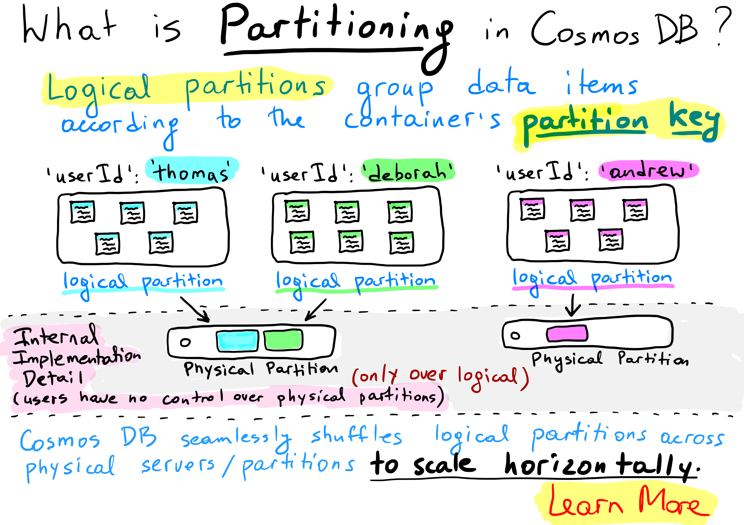

Slide 24
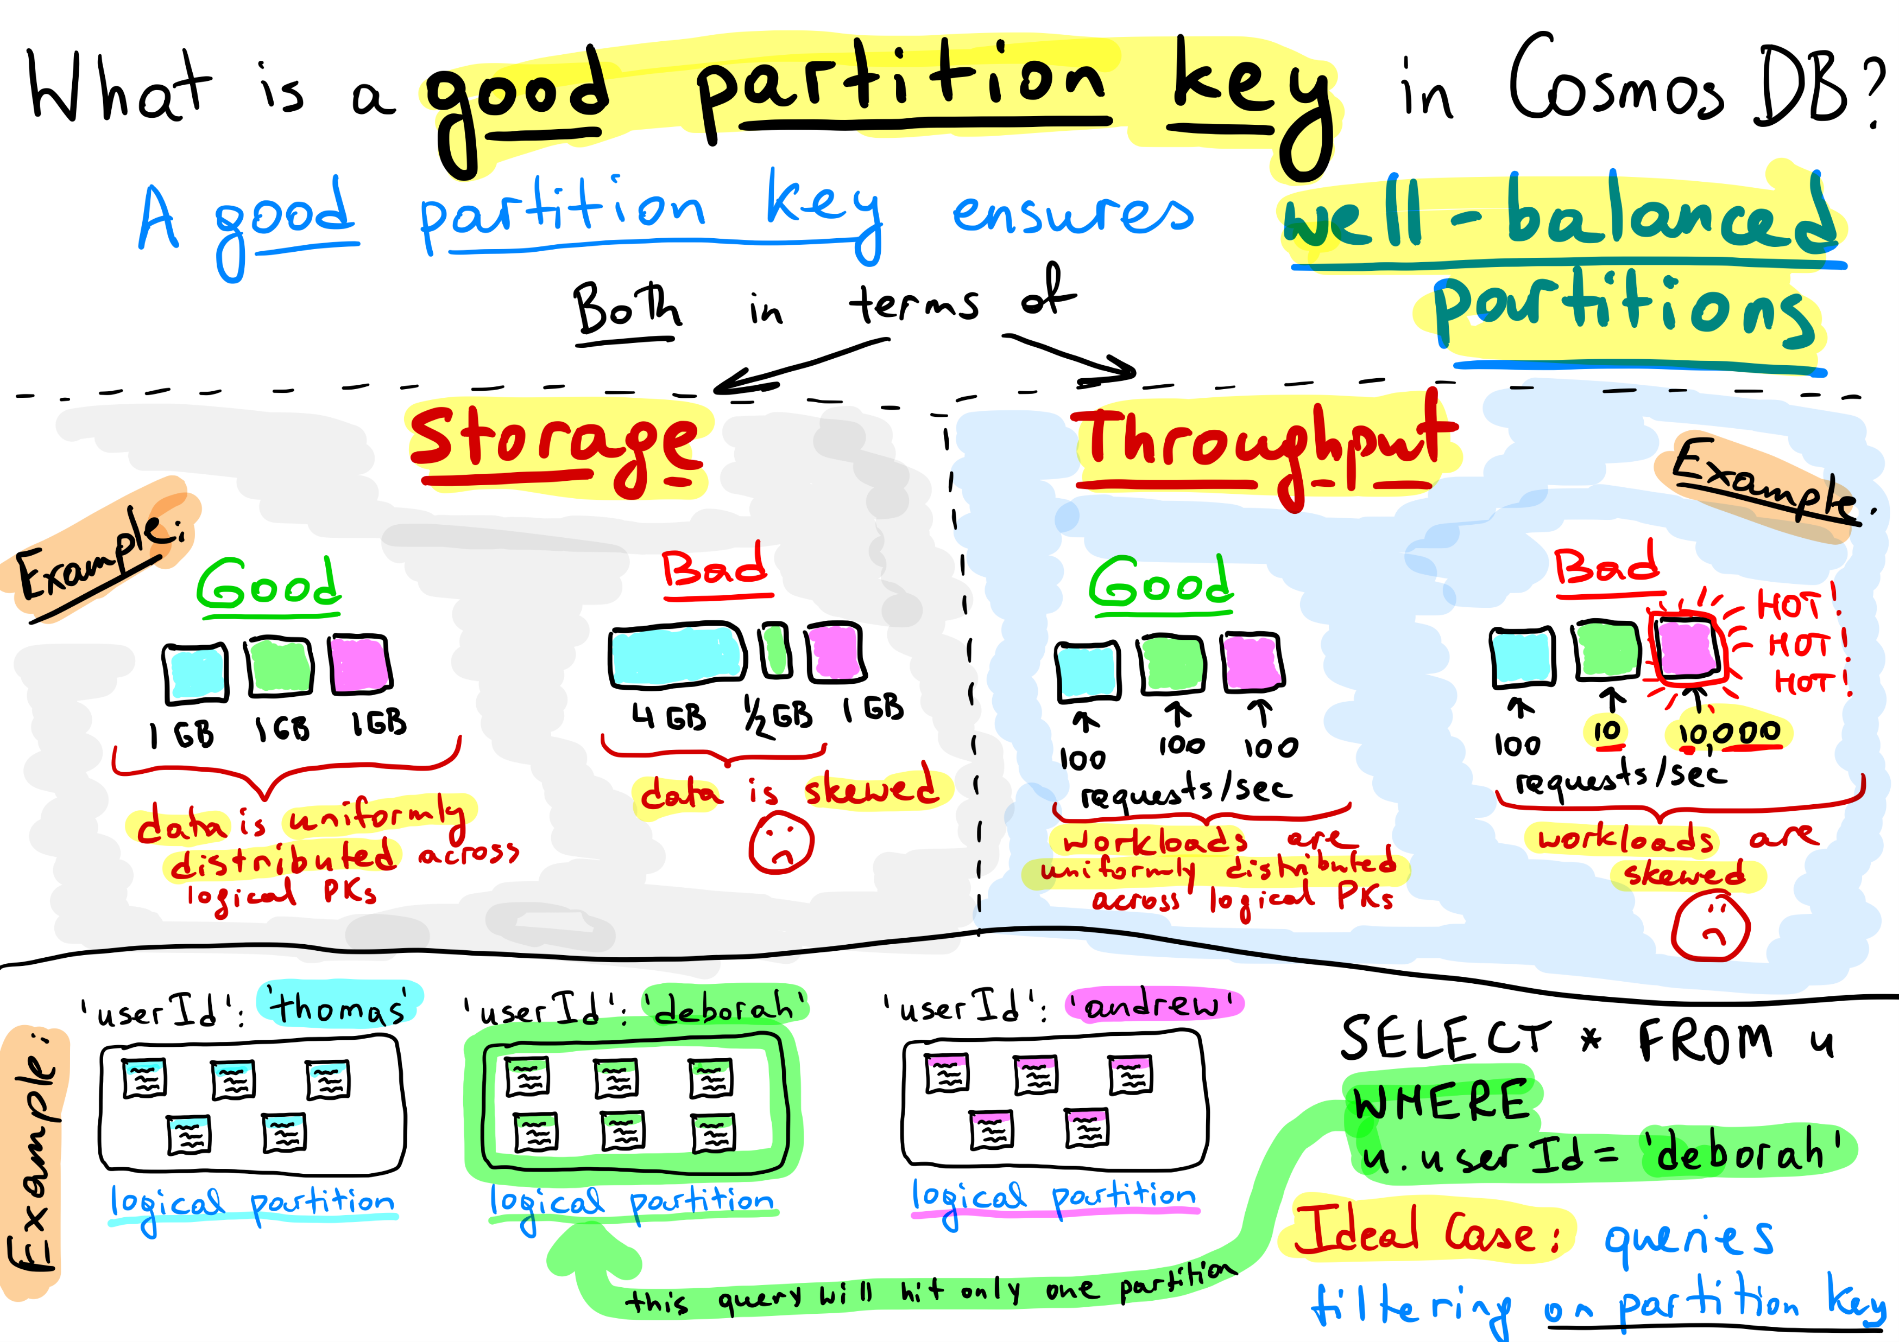

Slide 25
Modeling & Planning
Modeling data & configuring containers to take advantage of Azure Cosmos DB strengths.
This module will reference modeling in the context of all Azure Cosmos DB modules and APIs.

Slide 26
Data Model Considerations
Co-locate different entity types within one container
To Embed or to reference?
Denormalize properties across documents

Slide 27
Co-locating Entity Types Relational vs. NoSQL
One container per entity type
Like Having one entity per table in a relational database
A single container for multiple entity types
For some people it “Feels” weird, but it can greatly improve performance!
Useful when you need“join-like” capabilities and data is not already embedded
Introduce “type” property
Notes:
You could decide to have multiple entities per collection when you need multiple, related documents to sit in the same partition:
If you need “join-like” capabilities and data is not already embedded.
Modify several entities in a single transaction (for this you need multiple, related documents to sit in the same partition).
Ability to query across multiple entity types with a single network request.
For further information refer to:
https://docs.microsoft.com/en-us/azure/cosmos-db/modeling-data

Slide 28
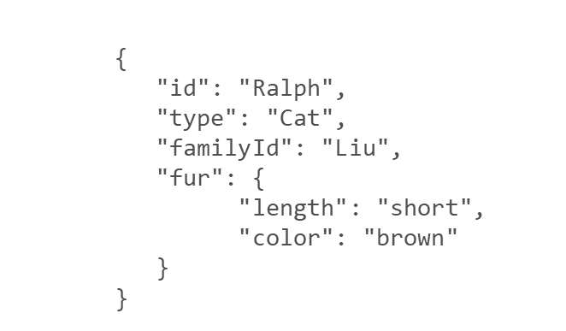
Co-locating Entity Types
For example, we have two types of documents: cat and person.
CONTAINERS
Containers do NOT enforce schemas
Annotate records with a “TYPE” property
CO-LOCATING TYPES IN THE SAME CONTAINER
Ability to query across multiple entity types with a single network request.
Suitable when different entity types
Share similar access patterns
Share the same partition key
{
"id": "Ralph",
"type": "Cat",
"familyId": "Liu",
"fur": {
"length": "short",
"color": "brown"
}
}
{
"id": "Andrew",
"type": "Person",
"familyId": "Liu",
"worksOn": "Azure Cosmos DB"
}
We can query both types of documents without needing a JOIN simply by running a query without a filter on type:
SELECT * FROM c WHERE c.familyId = "Liu"
If we wanted to filter on type = “Person”, we can simply add a filter on type to our query:
SELECT * FROM c WHERE c.familyId = "Liu" AND c.type = "Person"

Slide 29
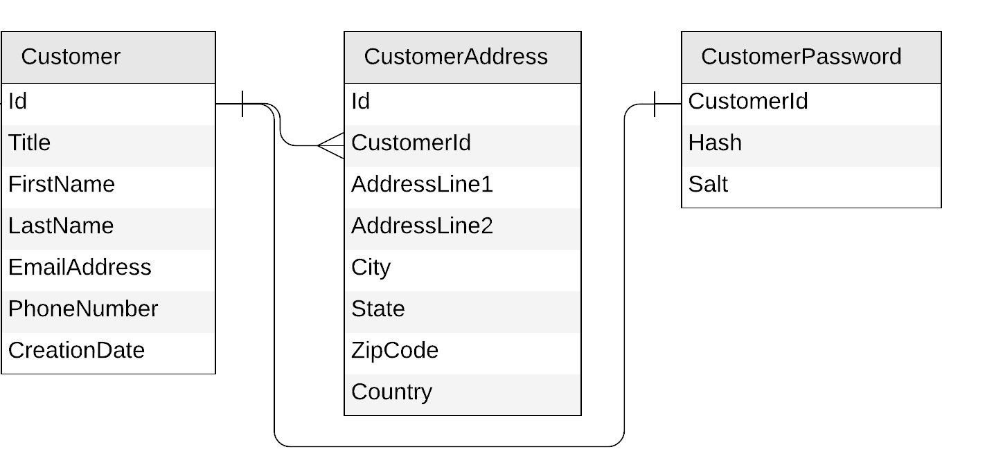
To Embed Or To Reference?
{
"id": "…",
"title": "…",
"firstName": "…",
"lastName": "…",
"emailAddress": "…",
"phoneNumber": "…",
"creationDate": "…",
"addresses": [{
"addressLine1": "…",
"addressLine2": "…",
"city": "…",
"state": "…",
"zipCode": "…",
"country": "…"
}],
"password": {
"hash": "…",
"salt": "…"
}
}
{
"id": "…",
"title": "…",
"firstName": "…",
"lastName": "…",
"emailAddress": "…",
"phoneNumber": "…",
"creationDate": "…"
}
{
"id": "…",
"customerId": "…",
"addressLine1": "…",
"addressLine2": "…",
"city": "…",
"state": "…",
"zipCode": "…",
"country": "…"
}
{
"id": "…",
"customerId ": "…",
"hash": "…",
"salt": "…"
}
Embed
Reference

Slide 30
To Embed Or To Reference?
EMBED
1:1 relationship
1:few relationship
Related items are queried or updated together
REFERENCE
1:many relationship (especially if unbounded)
Many:many relationship
Related items are queried or updated independently

Slide 31
Denormalize Properties Across Documents
When working with non-relational databases, we optimize our data models to make sure that all the required data is ready to be served by the queries

Slide 32
Denormalize Properties Across Documents Common scenarios
Better performance: Create materialized views that pre-compute and cache expensive queries → ready-to-consume results
Build scalable pre-computed aggregations

Slide 33
Denormalize Properties Across Documents
Trip
{
"id": "e2c7ca5e-2ef1-4ac2-836d-74124811516c",
"partitionKey": "DB2JXBWBLCL09FJFU",
"entityType": "Trip",
“tripId": " ed96feb9-957e-4d30-873e-7a4f12266022 ",
"consignmentId": "ed96feb9-957e-4d30-873e-7a4f12266022",
"plannedTripDistance": 190.53,
"location": "OR",
…
"status": "Pending",
"timestamp": "0001-01-01T00:00:00", “packages ":
[
{
“packageId": " 26128844-cc3f-4808-99f7-2b142ad002e5",
"height": 33.37,
"length": 41.45,
"width": 20.96
}
…
{
“packageId": " 12884426-dd3f-4909-f799-d002e52b142a",
"height": 22.26,
"length": 52.56,
"width": 22.85
}
[
}
Consignment
{
"id": "ed96feb9-957e-4d30-873e-7a4f12266022",
"partitionKey": “HHSDDSD",
"entityType": “Consignment",
"customer": "Bellows College",
"deliveryDueDate": "2019-10-20T05:56:44.7367547Z“
…
}
Notes:
As you can see here is a ConsignmentId and this is a reference to another document that contains a lot of data, this is the document that expresses the customer logistics requirements, the packages they want picked up and where they want them delivered.
One of the things that most of our queries does is look up from this document is the customer name for display in the UI, this requires that we include the Consignment document in our query results, so we have a similar problem to our previous one, now between trip data and consignment.

Slide 34
Denormalize Properties Across Documents
Trip
{
"id": "e2c7ca5e-2ef1-4ac2-836d-74124811516c",
"partitionKey": "DB2JXBWBLCL09FJFU",
"entityType": "Trip",
“tripId": " ed96feb9-957e-4d30-873e-7a4f12266022 ",
"consignmentId": "ed96feb9-957e-4d30-873e-7a4f12266022",
“consignmentCustomer": "Bellows College",
"plannedTripDistance": 190.53,
"location": "OR",
…
"status": "Pending",
"timestamp": "0001-01-01T00:00:00", “packages ":
[
{
“packageId": " 26128844-cc3f-4808-99f7-2b142ad002e5",
"height": 33.37,
"length": 41.45,
"width": 20.96
}
…
{
“packageId": " 12884426-dd3f-4909-f799-d002e52b142a",
"height": 22.26,
"length": 52.56,
"width": 22.85
}
[
}
Consignment
{
"id": "ed96feb9-957e-4d30-873e-7a4f12266022",
"partitionKey": “HHSDDSD",
"entityType": “Consignment",
"customer": "Bellows College",
"deliveryDueDate": "2019-10-20T05:56:44.7367547Z“
…
}
What happens when the customer name changes?
Notes:
So why would I not just embed these documents,
And the consignment document is often significantly larger than the trip document and contains data that the majority of queries are not interested in. In actual fact 90% of the queries are only interested in getting the additional customer name for display purposes.

Slide 35

Cosmos DB's change feed
The change feed is an API exposed by Cosmos DB containers
It streams any change happening in a container (document creation or update)

Slide 36

Keeping Everything in sync
Consignment
Trip

Slide 37
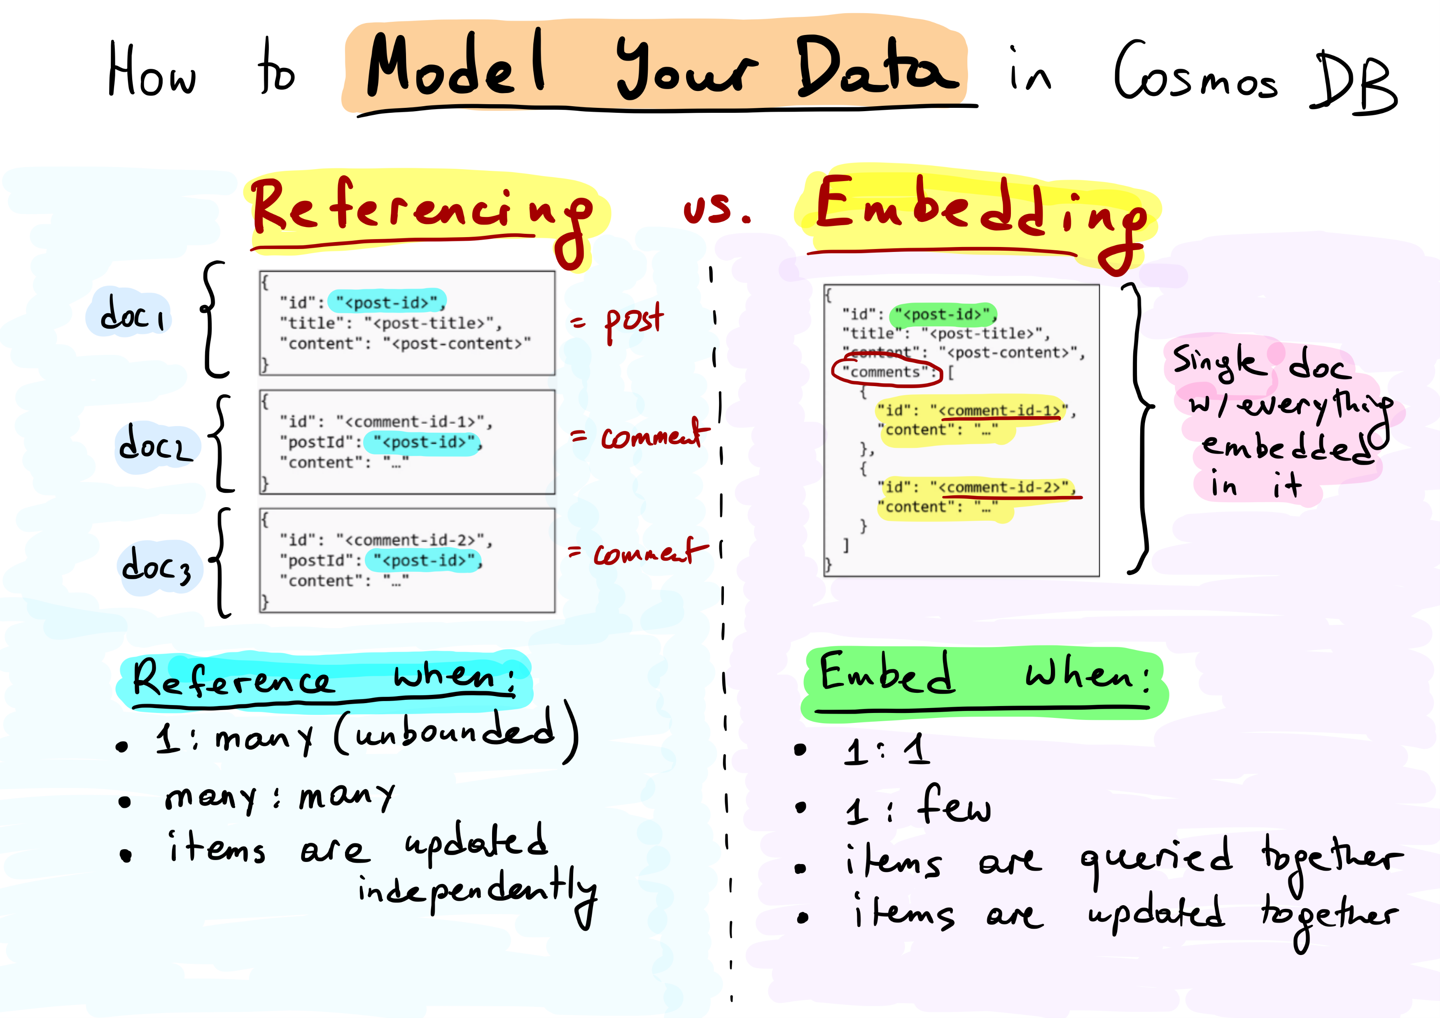

Slide 38
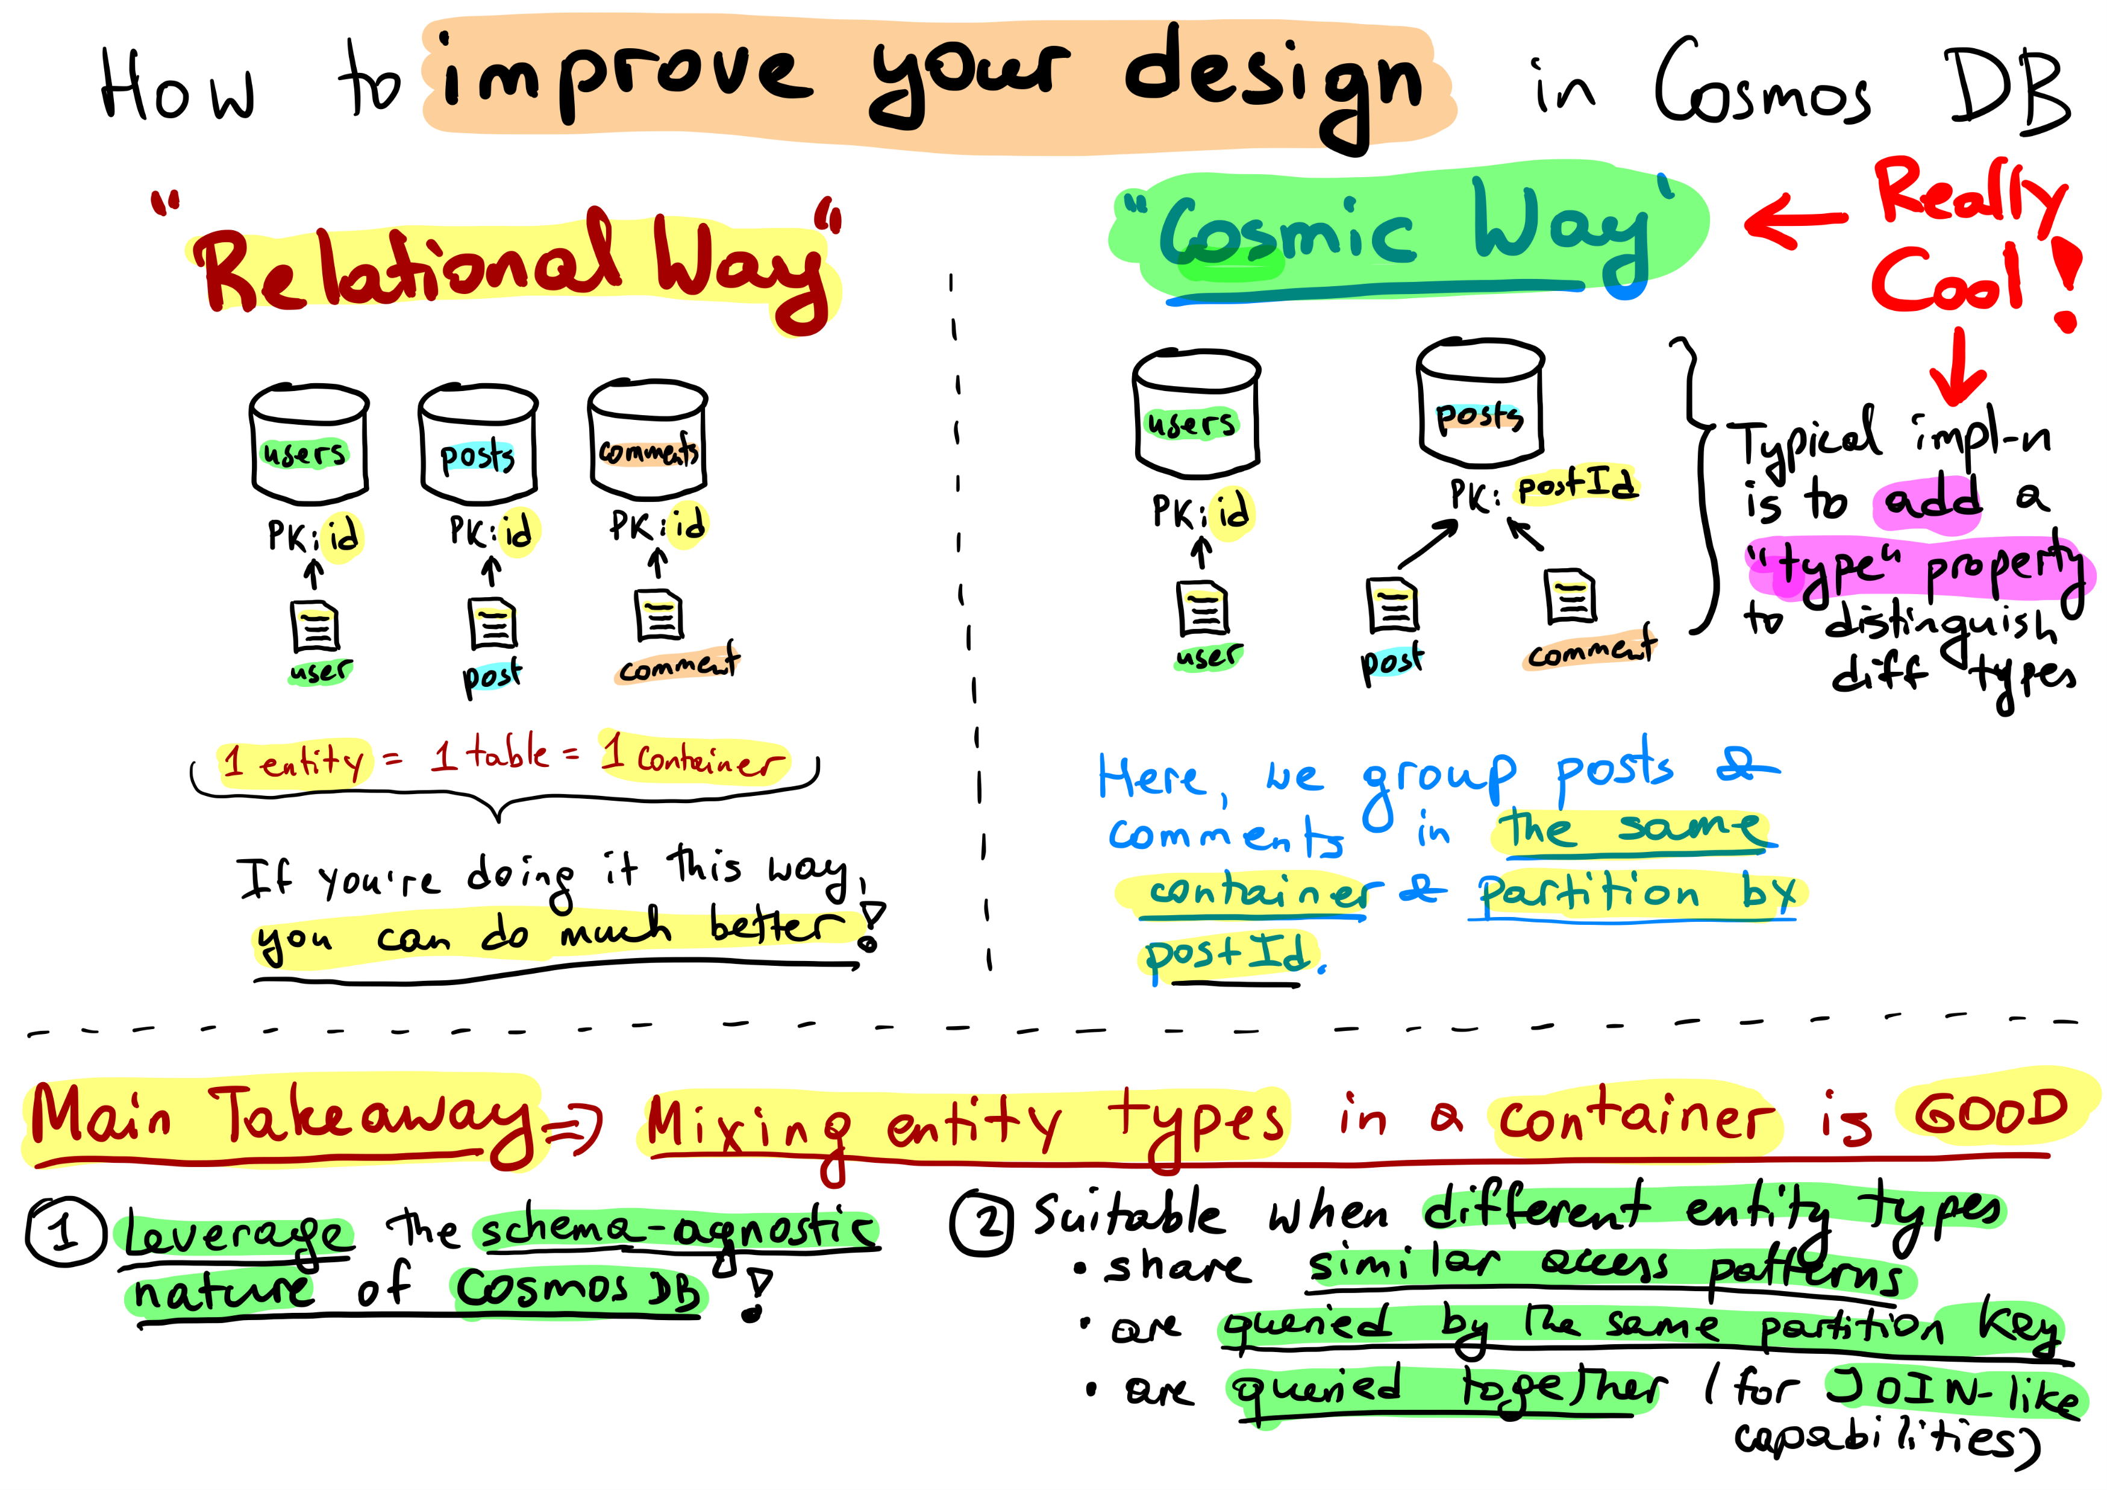

Slide 39
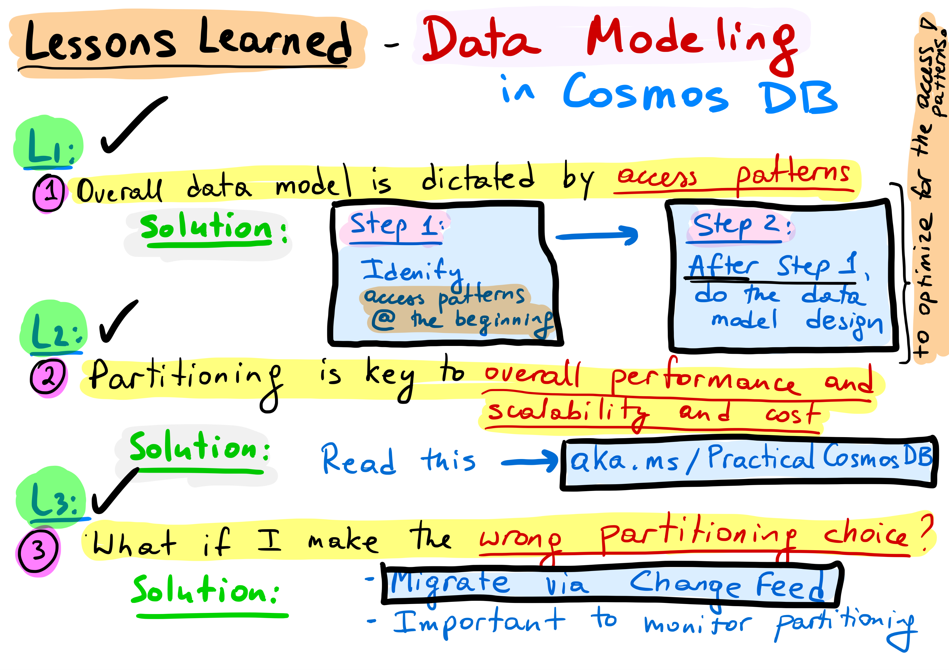

Slide 40
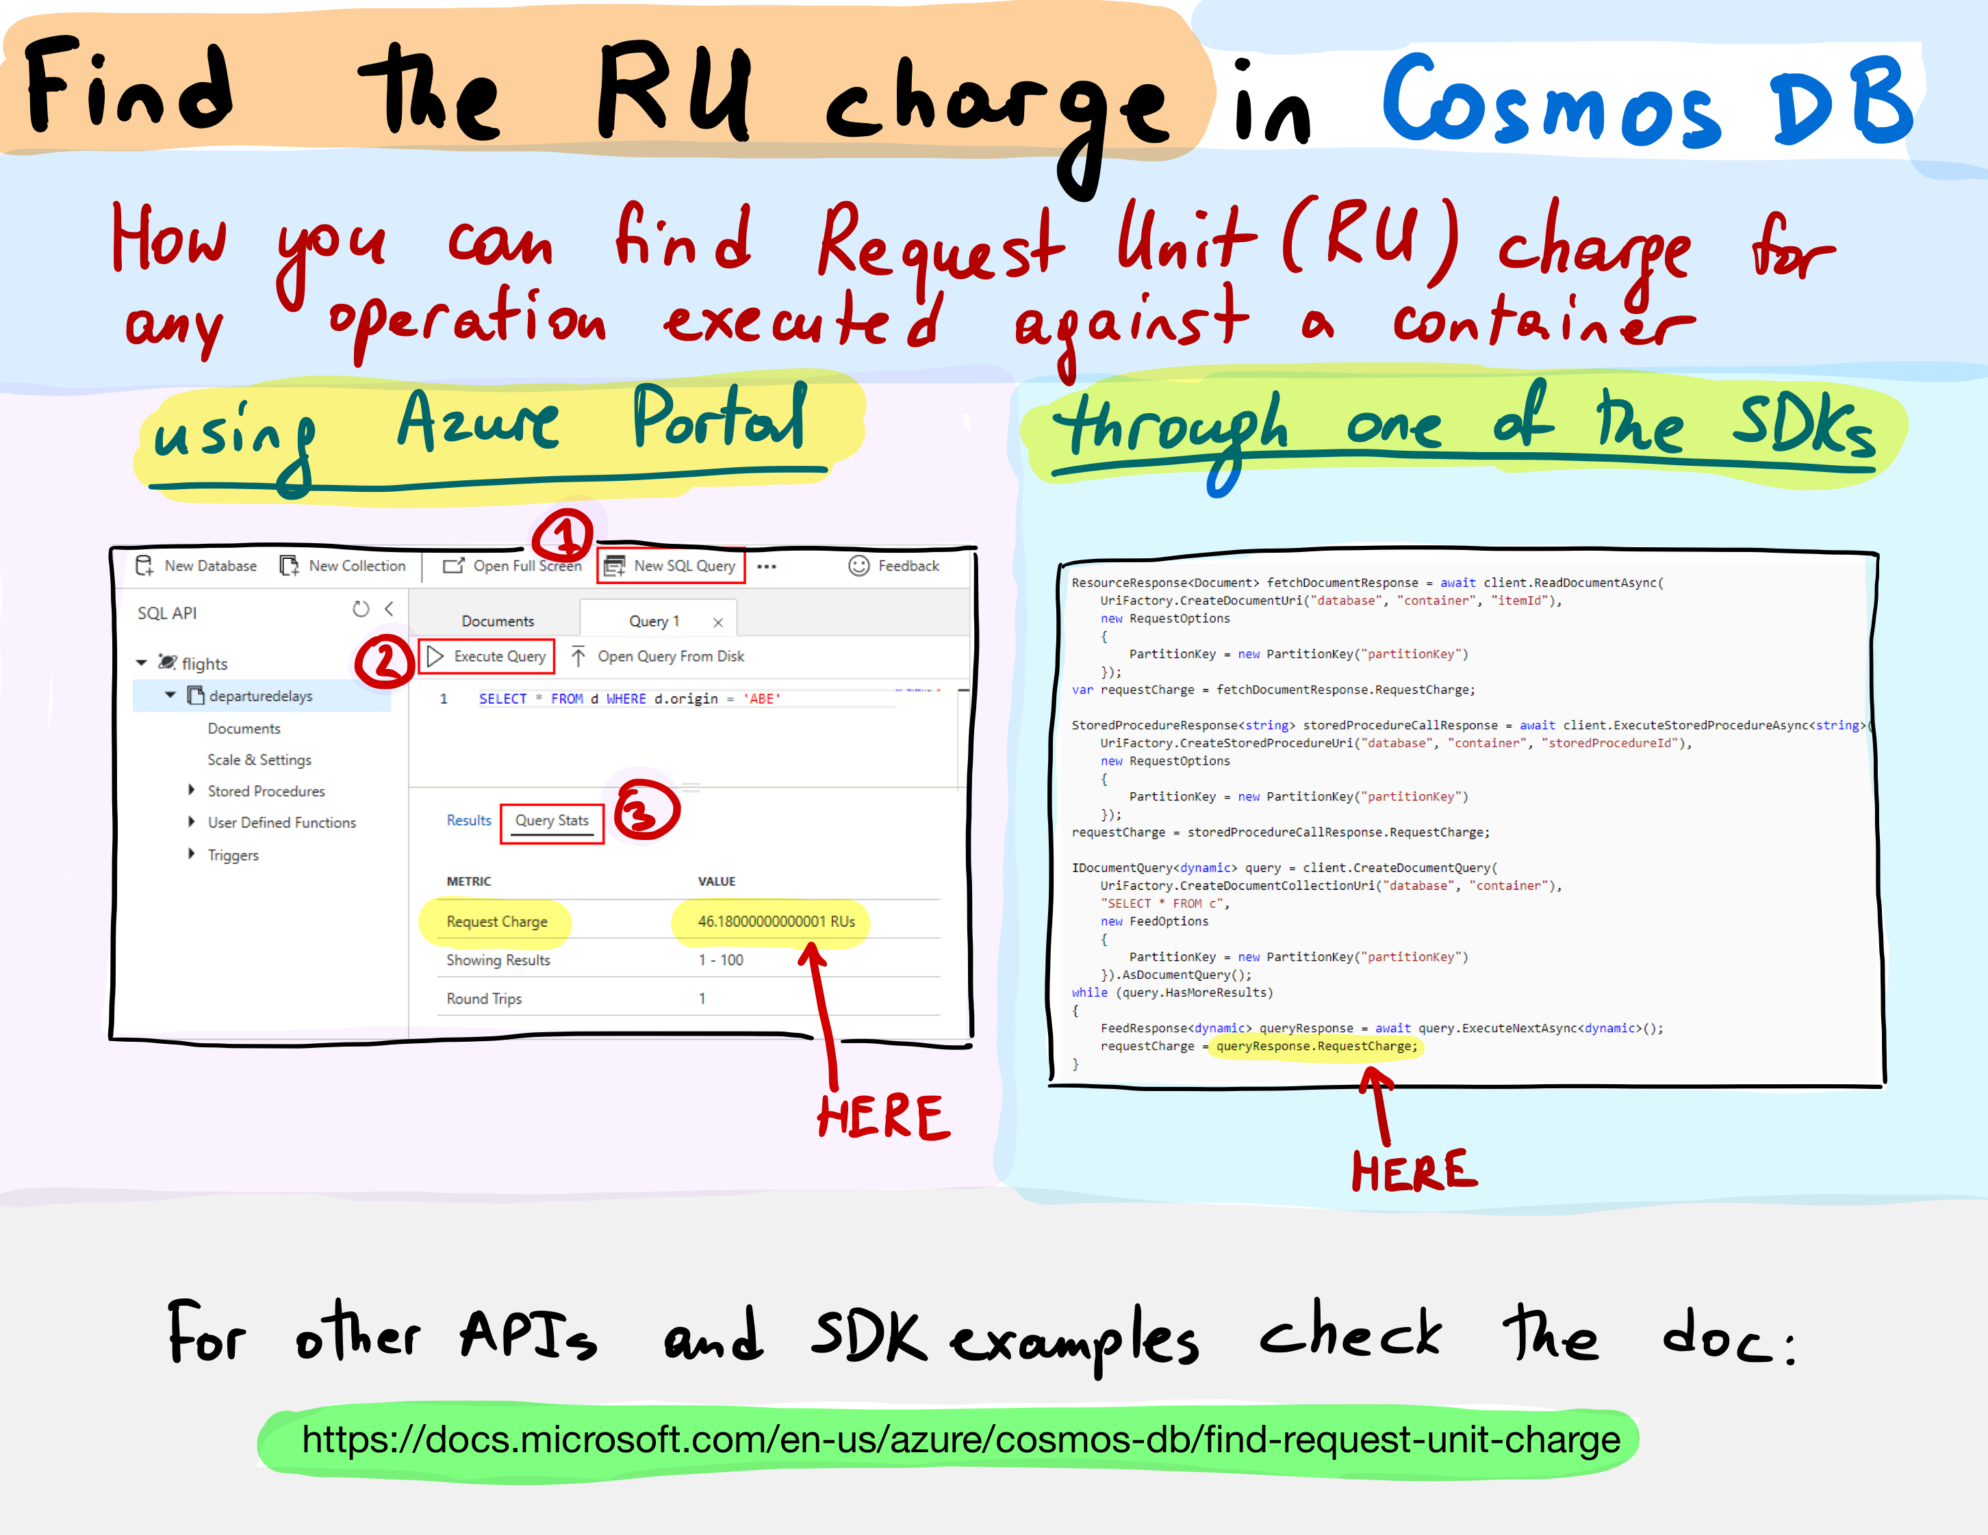

Slide 41
Key Takeaways
Identify key access patterns and design for them
Partitioning is critical for best performance and scalability
Materialize relations between entities by:
Embedding
Denormalizing and pre-aggregating
Storing related entities in the same container
Different methods to implement denormalization
Using the change feed
Using stored procedures or transactional batch

Slide 42
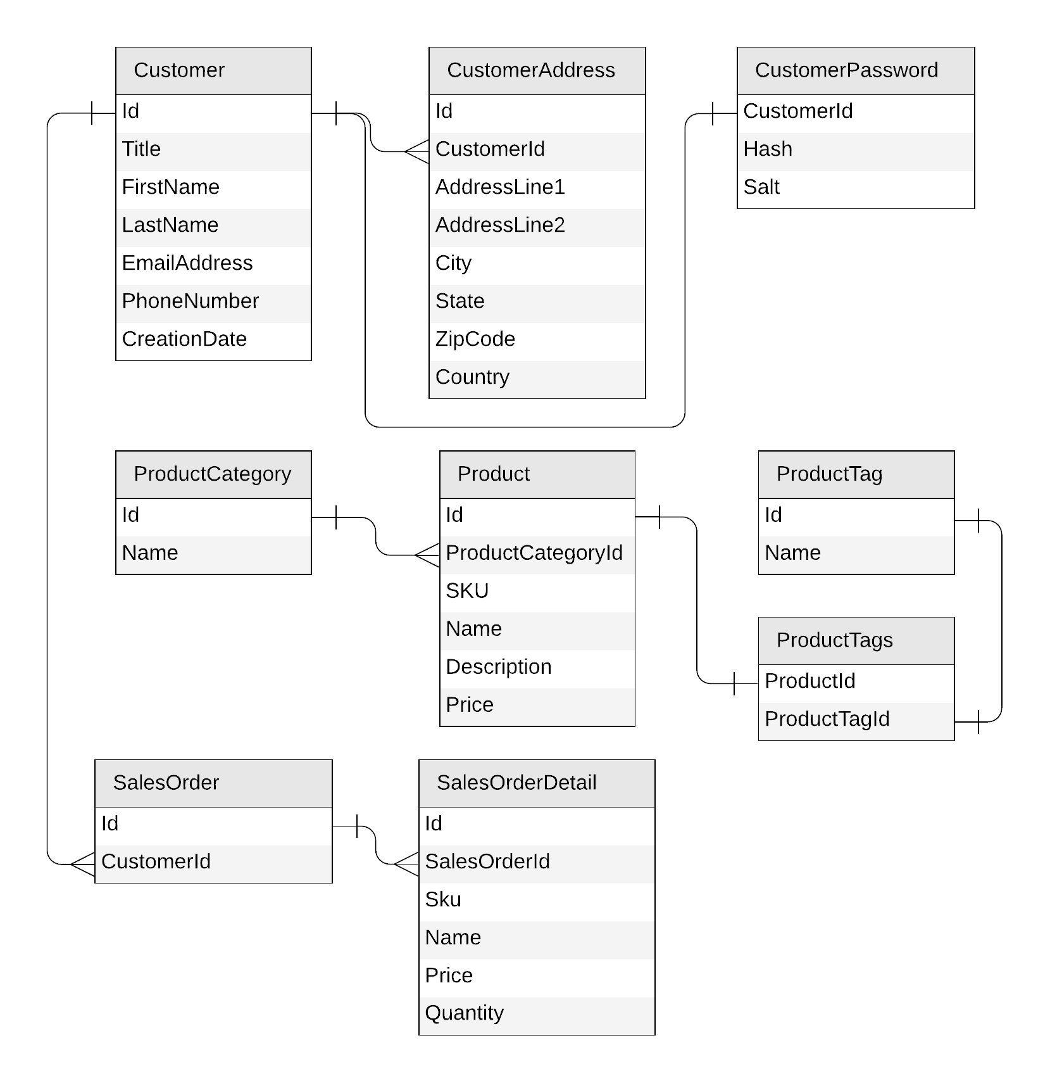
Let's look at a concrete example
E-commerce workload
Customers
Products
Categories
Tags
Sales Orders

Slide 43
Identifying operations for our app
Create a customer
Edit a customer
Retrieve a customer
Create a product category
Edit a product category
List all product categories
Create a product tag
Edit a product tag
List all product tags
Create a product
Edit a product
List all products from a category (with name of category)
Create a sales order
List all sales order for a customer
Top 2 customers by number of sales orders

Slide 44
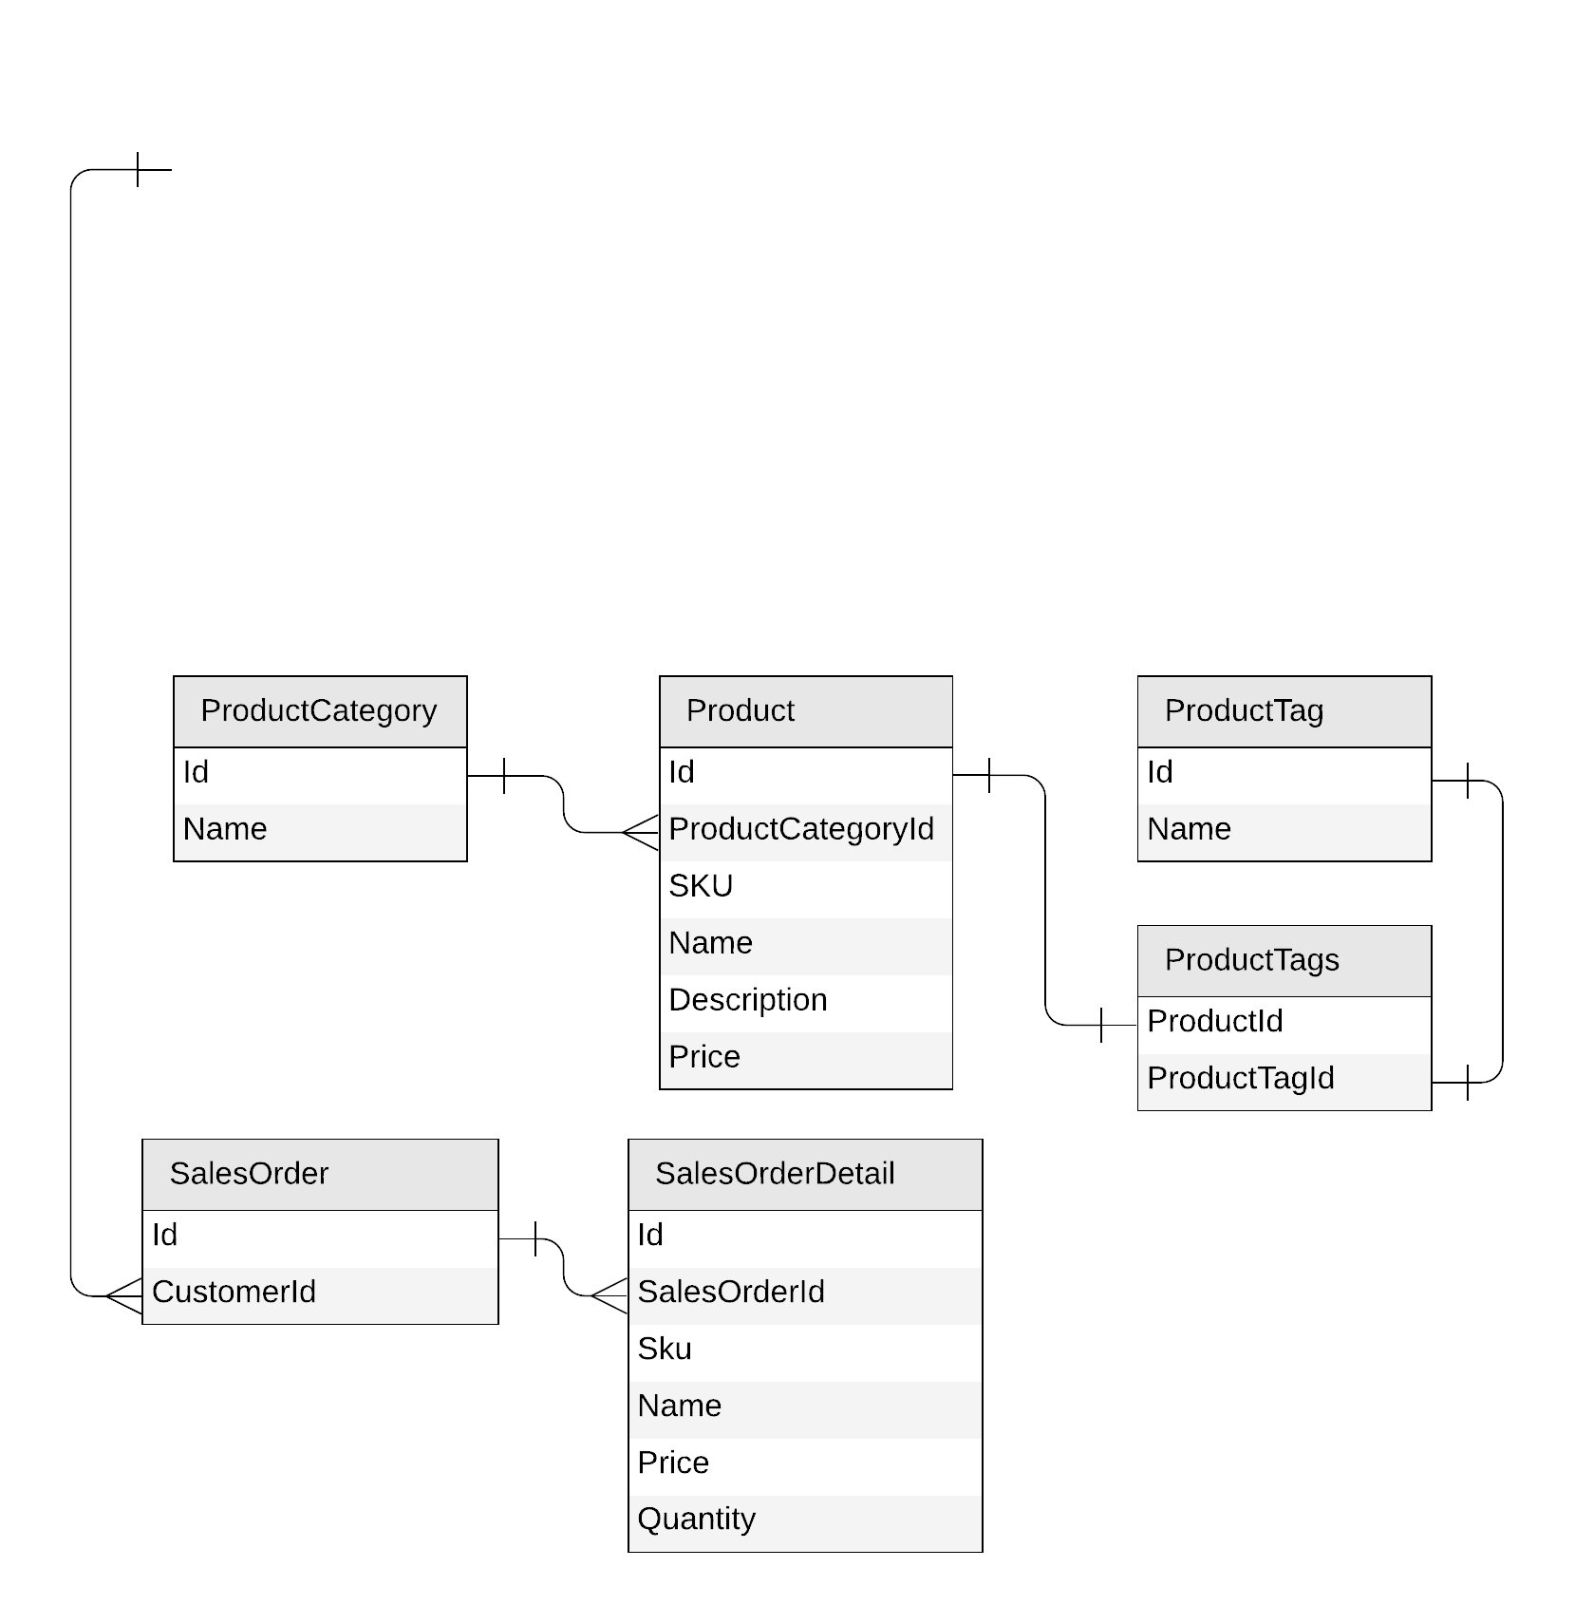
Let’s get started!

Slide 45






Slide 46
Results
Query | SQL | RU/s
List all categories | SELECT * FROM categories c | 2.32
List all products from category ‘Clothing, Home & Computers’ | SELECT VALUE c.CategoryId FROM categories c WHERE c.CategoryName = 'Clothing, Home & Computers' SELECT * FROM product_categories c WHERE c.CategoryId = '3' SELECT * FROM products c WHERE c.ProductId IN ('0', '4', '5') | 3.02 + 2.88 + 3.09 = 8.99
List all sales order for customer #7 | SELECT VALUE c.SalesOrderId FROM sales_orders c WHERE c.CustomerId = '7' SELECT * FROM sales_orders_details c WHERE c.SalesOrderId IN ('7','4') | 3.05 + 2.93 = 5.98
Top 2 customers by number of sales orders | -

Slide 47
Choosing a partition key for customers
{
"id": "…",
"title": "…",
"firstName": "…",
"lastName": "…",
"emailAddress": "…",
"phoneNumber": "…",
"creationDate": "…",
"addresses": [{
"addressLine1": "…",
"addressLine2": "…",
…
}],
"password": {
"hash": "…",
"salt": "…"
}
}
customer
PK: ?

Slide 48
Choosing a partition key for customers
customer
PK: ?
Create a customer
Edit a customer
Retrieve a customer
(by id)

Slide 49
Choosing a partition key for customers
customer
PK: CustomerId
Create a customer
Edit a customer
Retrieve a customer
(by id)

Slide 50
Choosing a partition key for customers
customer
PK: CustomerId

Slide 51
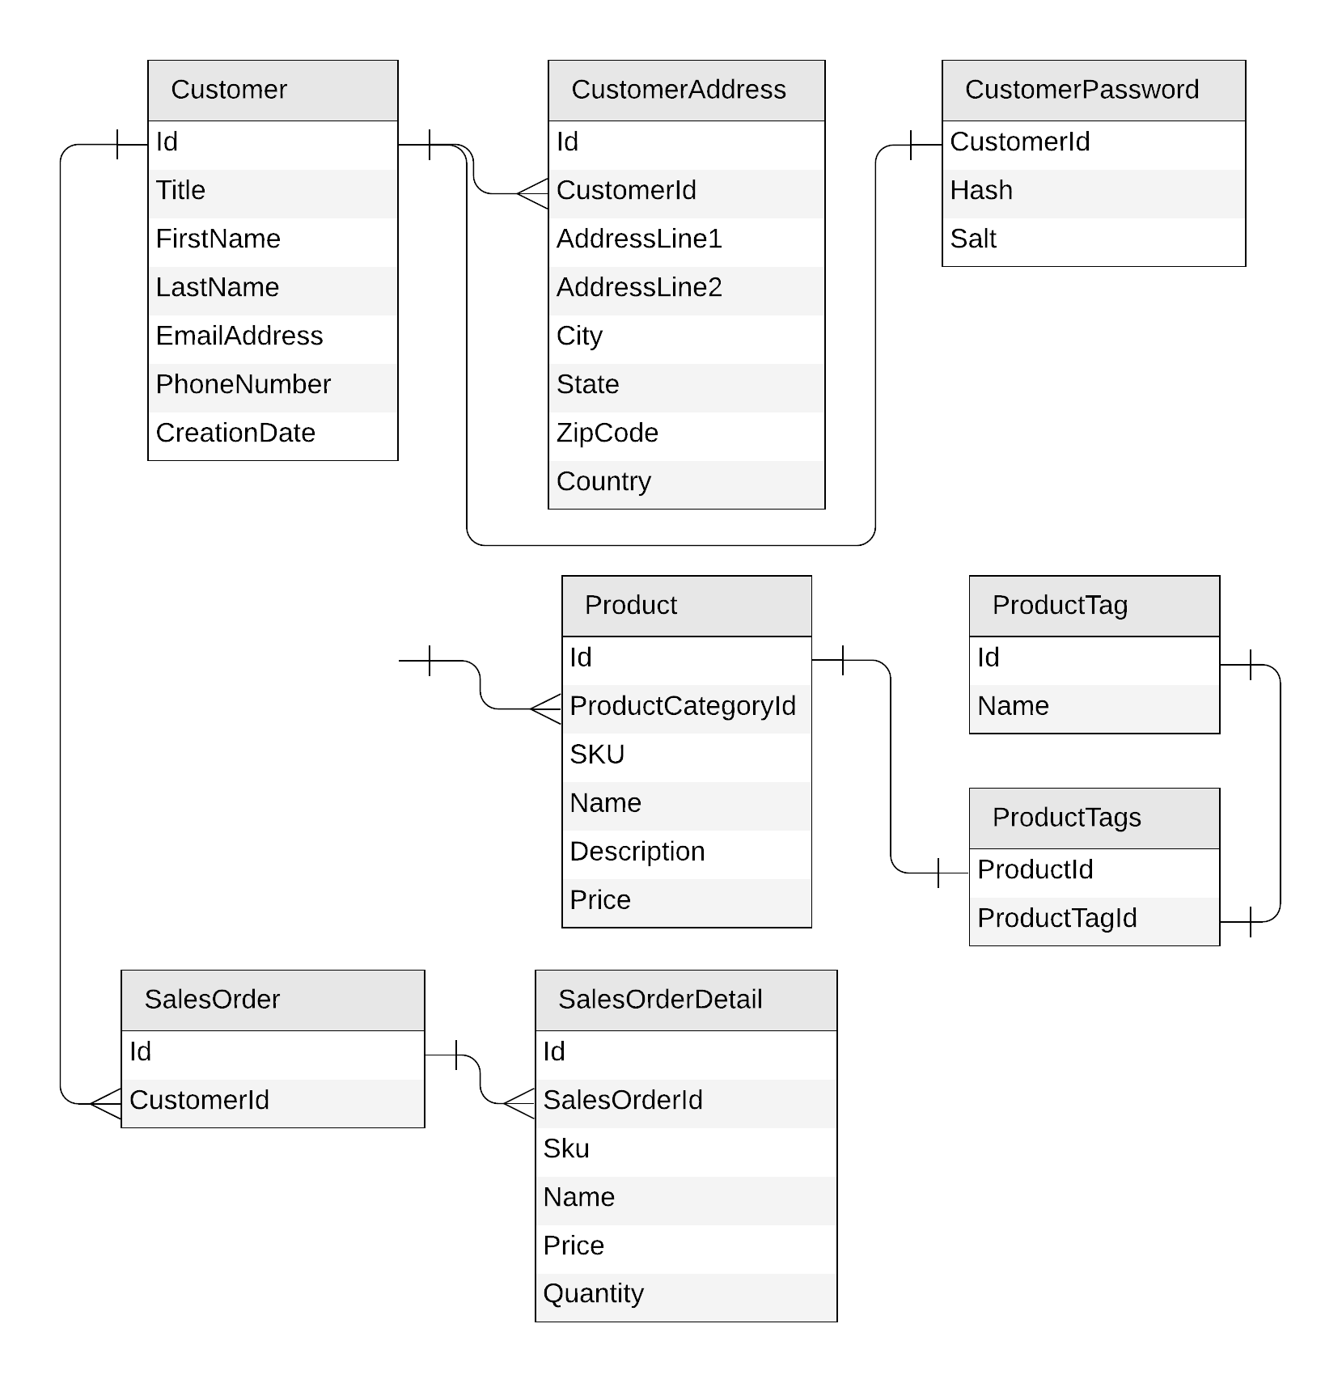
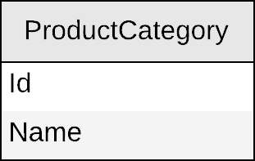
Next: products

Slide 52
Product category
{
"CategoryId": "…",
"CategoryName": "…"
}

Slide 53
Product category
productCategory
PK: ?
{
"CategoryId": "…",
"CategoryName": "…"
}

Slide 54
Product category
productCategory
PK: ?
Create a product category
Edit a product category
List all product categories
SELECT * FROM c

Slide 55
Product category
productCategory
PK: type
{
"categoryId": "…",
"categoryName": "…",
"type": "category"
}
SELECT * FROM c WHERE
c.type = “category”

Slide 56
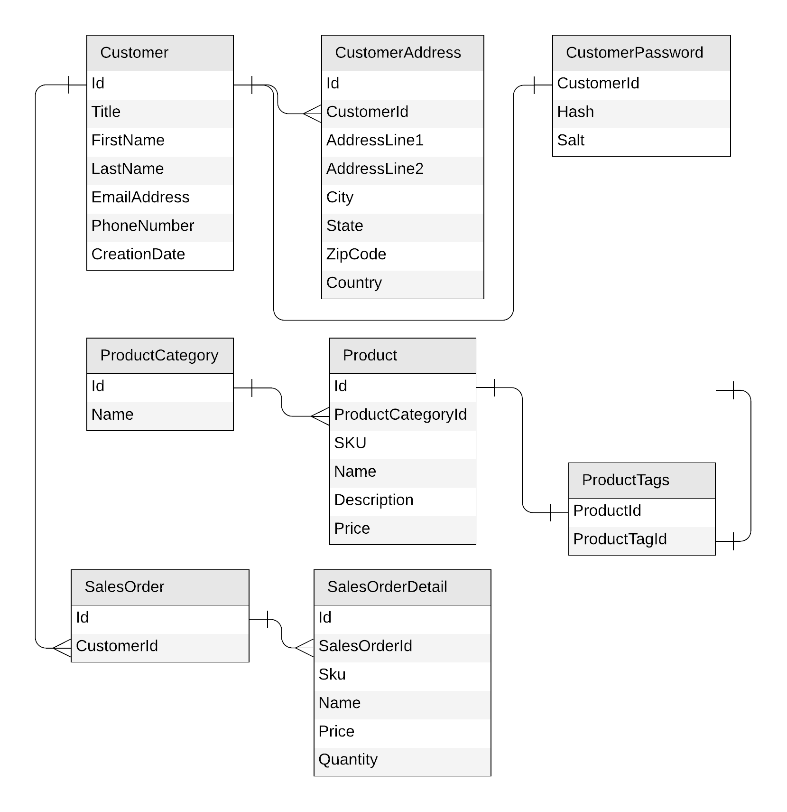
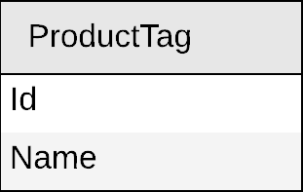
Next: product tag

Slide 57
Product tag
{
"tagId": "…",
"tagName": "…"
}

Slide 58
Product tag
productTag
PK: ?
{
"tagId": "…",
"tagName": "…"
}

Slide 59
Product tag
productTag
PK: ?
Create a product tag
Edit a product tag
List all product tags

Slide 60
Product tag
productTag
PK: type
{
"tagId": "…",
"tagName": "…",
"type": "tag"
}

Slide 61
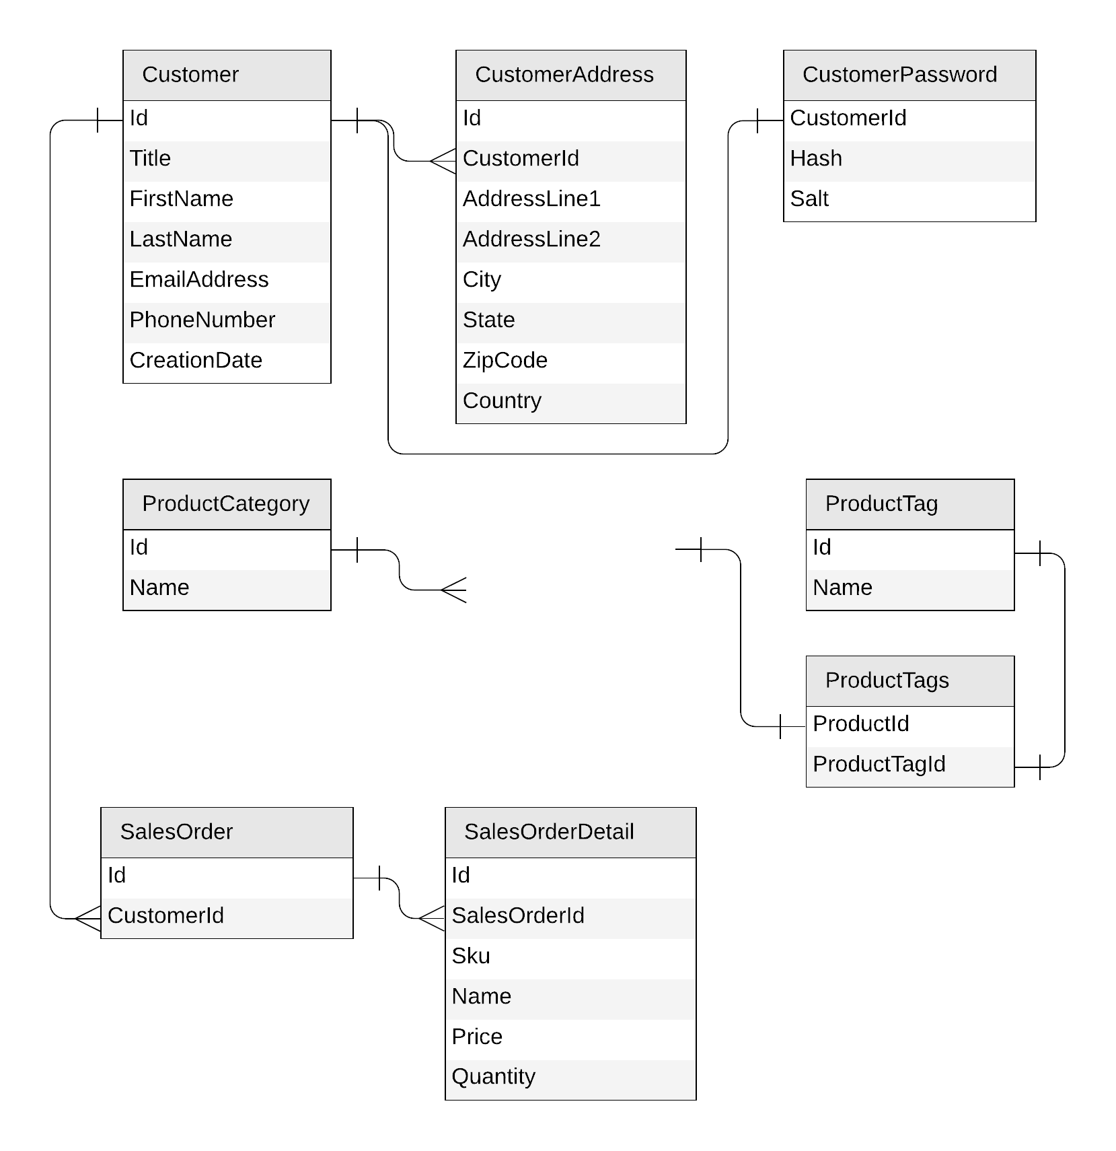
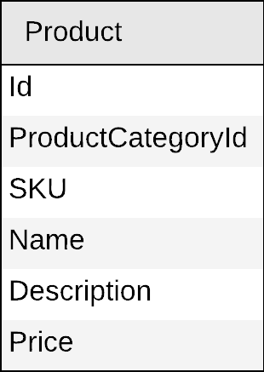
Next: product

Slide 62
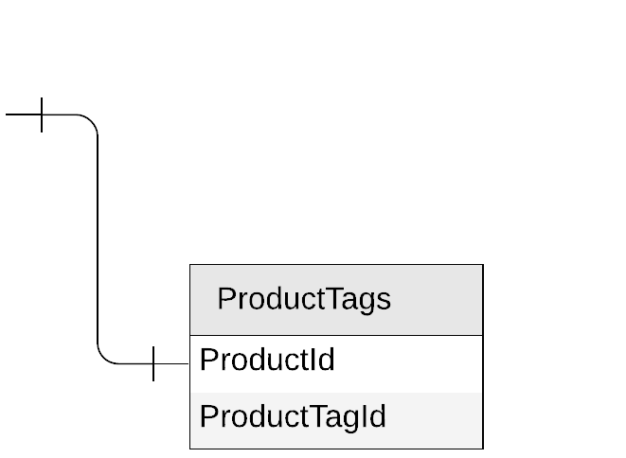
Product
{
"id": "…",
"categoryId": "…",
"sku": "…",
"name": "…",
"description": "…",
"price": …
}

Slide 63
Products
{
"id": "…",
"categoryId": "…",
"sku": "…",
"name": "…",
"description": "…",
"price": …,
"tagIds": [
"…",
"…"
]
}

Slide 64
Products
{
"id": "…",
"categoryId": "…",
"sku": "…",
"name": "…",
"description": "…",
"price": …,
"tagIds": [
"…",
"…"
]
}
product
PK: ?

Slide 65
Products
Create a product
Edit a product
List all products from a category (with name of category and tags)
product
PK: ?
SELECT * FROM c WHERE c.categoryId = 'CategoryA'
CategoryA
CategoryB
CategoryC

Slide 66
Products
{
"id": "…",
"categoryId": "…",
"sku": "…",
"name": "…",
"description": "…",
"price": …,
"tagIds": [
"…",
"…"
]
}
category name?
product
PK: categoryId
tag names?

Slide 67

Products: how to return category and tag names?
product
SELECT * FROM c WHERE c.categoryId = 'CategoryA'
WHERE ARE MY JOINS?
productCategory
SELECT c.name FROM c WHERE c.id = 'CategoryA'
productTag
SELECT * FROM c
WHERE c.id IN ('<tagId1>', '<tagId2>', '<tagId3>')

Slide 68
Products: denormalizing category and tag names
{
"id": "…",
"categoryId": "…",
"categoryName": "…",
"sku": "…",
"name": "…",
"description": "…",
"price": …,
"tags": [
{
"id": "…"
"name": "…"
},
{
"id": "…"
"name": "…"
},
]
}
product
PK: categoryId

Slide 69
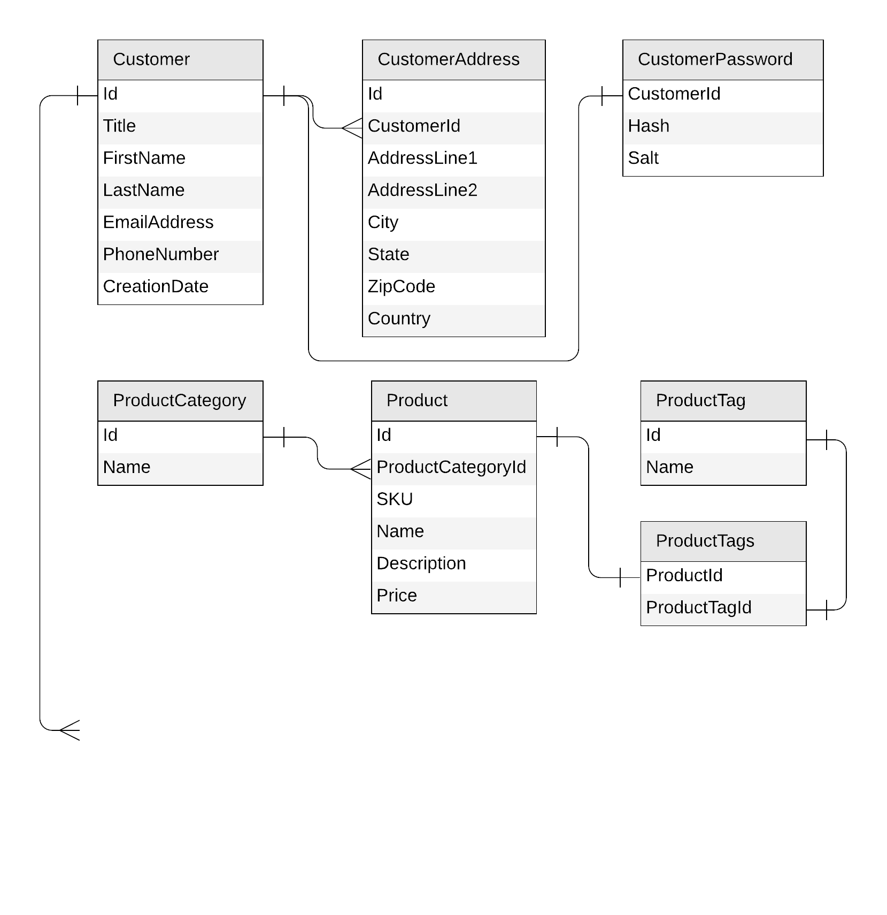
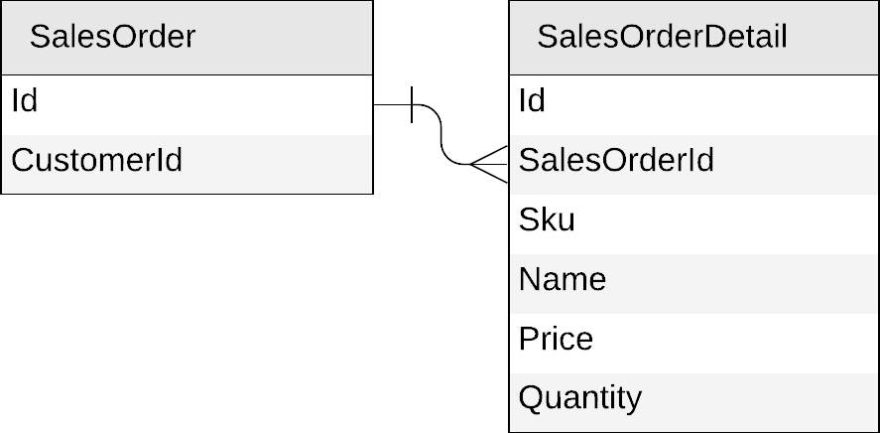
Next: sales orders

Slide 70
Sales orders
{
"id": "…",
"customerId": "…"
}
{
"id": "…",
"salesOrderId": "…",
"sku": "…",
"name": "…",
"description": "…",
"price": …,
"quantity": …
}

Slide 71
Sales orders
{
"id": "…",
"customerId": "…",
"details": [{
"sku": "…",
"name": "…",
"description": "…",
"price": …,
"quantity": …
}]
}

Slide 72
Sales orders
{
"id": "…",
"customerId": "…",
"details": [{
"sku": "…",
"name": "…",
"description": "…",
"price": …,
"quantity": …
}]
}
salesOrder
PK: ?

Slide 73
Sales orders
salesOrder
PK: ?
Create a sales order
List all sales orders for a customer
Query top 10 customers by number of sales orders

Slide 74
Sales orders
salesOrder
PK: ?
Create a sales order
List all sales orders for a customer
SELECT * FROM c WHERE c.customerId = 'CustomerA'
CustomerA
CustomerB
CustomerC

Slide 75
Sales orders
{
"id": "…",
"customerId": "…",
"details": [{
"sku": "…",
"name": "…",
"description": "…",
"price": …,
"quantity": …
}]
}
salesOrder
PK: customerId

Slide 76
Products: keeping everything in sync
productCategory
ProductCategory
product
Product
productTag
ProductTag

Slide 77
Products: keeping everything in sync
productCategory
product
productTag

Slide 78














Slide 79
Results
Query | SQL | Start | Optim-1
List all categories | SELECT * FROM categories c | 2.32 | 2.32
List all products from category ‘Clothing, Home & Computers’ | SELECT * FROM products_1 c WHERE c.CategoryName='Sports, Shoes & Health' | 8.99 | 2.89
List all sales order for customer #7 | SELECT * FROM sales_orders_1 s WHERE s.CustomerId = '7' | 5.98 | 2.86
Top 2 customers by number of sales orders | -

Slide 80
Sales orders
{
"id": "…",
"customerId": "…",
"details": [{
"sku": "…",
"name": "…",
"description": "…",
"price": …,
"quantity": …
}]
}
salesOrder
PK: customerId
{
"id": "…",
"title": "…",
"firstName": "…",
"lastName": "…",
"emailAddress": "…",
"phoneNumber": "…",
…
}
customer
PK: id

Slide 81
Sales orders
{
"id": "…",
"customerId": "…",
"details": [{
"sku": "…",
"name": "…",
"description": "…",
"price": …,
"quantity": …
}]
}
salesOrder
PK: customerId
{
"id": "…",
"title": "…",
"firstName": "…",
"lastName": "…",
"emailAddress": "…",
"phoneNumber": "…",
…
}
customer
PK: id

Slide 82
Sales orders: mixing with customers
{
"id": "…",
"customerId": "…",
"details": [{
"sku": "…",
"name": "…",
"description": "…",
"price": …,
"quantity": …
}]
}
customer
PK: id
{
"id": "…",
"title": "…",
"firstName": "…",
"lastName": "…",
"emailAddress": "…",
"phoneNumber": "…",
…
}

Slide 83
Sales orders: mixing with customers
{
"id": "…",
"customerId": "…",
"details": [{
"sku": "…",
"name": "…",
"description": "…",
"price": …,
"quantity": …
}]
}
customer
PK: customerId
{
"id": "…",
"customerId": "…",
"title": "…",
"firstName": "…",
"lastName": "…",
"emailAddress": "…",
"phoneNumber": "…",
…
}

Slide 84
Sales orders: mixing with customers
{
"id": "…",
"type": "salesOrder",
"customerId": "…",
"details": [{
"sku": "…",
"name": "…",
"description": "…",
"price": …,
"quantity": …
}]
}
customer
PK: customerId
{
"id": "…",
"type": "customer",
"customerId": "…",
"title": "…",
"firstName": "…",
"lastName": "…",
"emailAddress": "…",
"phoneNumber": "…",
…
}

Slide 85
Sales orders: mixing with customers
customer
sales orders
customer
PK: customerId
CustomerA
CustomerB
CustomerC

Slide 86
Sales orders
customer
PK: customerId
Create a sales order
List all sales order for a customer
SELECT * FROM c WHERE c.customerId = 'CustomerA' AND c.type = 'salesOrder'

Slide 87
Sales orders
customer
PK: customerId
Create a sales order
List all sales orders for a customer
Query top 10 customers by number of sales orders

Slide 88













Slide 89
Results
Query | SQL | Start | Optim-1 | Optim-2
List all categories | SELECT * FROM product_metadata_2 c WHERE c.Type = "Category" | 2.32 | 2.32 | 2.94
List all products from category ‘Clothing, Home & Computers’ | SELECT * FROM products_1 c WHERE c.CategoryName='Sports, Shoes & Health' | 8.99 | 2.89 | 2.89
List all sales order for customer #7 | SELECT * FROM sales_orders_1 s WHERE s.CustomerId = '7' | 5.98 | 2.86 | 2.86
Top 2 customers by number of sales orders | -

Slide 90
Denormalizing the count of sales orders per customer
{
"id": "…",
"type": "customer",
"customerId": "…",
"title": "…",
"firstName": "…",
"lastName": "…",
"emailAddress": "…",
"phoneNumber": "…",
"creationDate": "…",
"addresses": [{
"addressLine1": "…",
"addressLine2": "…",
…
}],
"password": {
"hash": "…",
"salt": "…"
}
}

Slide 91
Denormalizing the count of sales orders per customer
{
"id": "…",
"type": "customer",
"customerId": "…",
"title": "…",
"firstName": "…",
"lastName": "…",
"emailAddress": "…",
"phoneNumber": "…",
"creationDate": "…",
"addresses": [{
"addressLine1": "…",
"addressLine2": "…",
…
}],
"password": {
"hash": "…",
"salt": "…"
},
"salesOrderCount": …
}

Slide 92
Denormalizing the count of sales orders per customer
customer
sales orders
customer
PK: customerId
CustomerA
CustomerB
CustomerC

Slide 93
Denormalizing the count of sales orders per customer
update the customer
add a sales order
customer
PK: customerId
CustomerA
CustomerB
CustomerC

Slide 94
Sales orders
customer
PK: customerId
Create a sales order
List all sales order for a customer
Query top 10 customers by number of sales orders
SELECT TOP 10 * FROM c WHERE c.type = 'customer'
ORDER BY c.salesOrderCount DESC

Slide 95










Slide 96




Slide 97
Results
Query | SQL | Start | Optim-1 | Optim-2 | Optim-3
List all categories | SELECT * FROM product_metadata_2 c WHERE c.Type = "Category" | 2.32 | 2.32 | 2.94 | 2.94
List all products from category ‘Clothing, Home & Computers’ | SELECT * FROM products_1 c WHERE c.CategoryName='Sports, Shoes & Health' | 8.99 | 2.89 | 2.89 | 2.89
List all sales order for customer #7 | SELECT * FROM sales_orders_1 s WHERE s.CustomerId = '7' | 5.98 | 2.86 | 2.86 | 2.86
Top 2 customers by number of sales orders | SELECT TOP 2 * FROM customers_3 c WHERE c.Type = 'Customer' ORDER BY c.SalesOrderCount DESC | - | - | - | 2.93

Slide 98
Going further
github.com/AzureCosmosDB/CosmicWorks
Demos and links to sample data.
aka.ms/PracticalCosmosDB – model a blog platform.
youtube.com/azurecosmosdb – awesome videos
devblogs.microsoft.com/cosmosdb– our blog

Slide 99
End

